Slide 1
Rekt ‘em
Game by Riyan imam

Slide 2
Elements of rekt ‘em
What kind of game is this? This is a web-based card game.
What is the goal of the game? The goal of the game is to lose all your cards before anyone else. However, there are ways to interfere and/ or mess up your opponents chances of winning!
How was this game created? With HTML and CSS.

Slide 3
High-level information of rekt ‘em
Where is the game currently? Currently we have a simple demo of the game.
Where would you like the game to go? To a fully developed, AAA title that I can sell on Steam for $60. Then, I will also release DLC for $30 more. Easy money.
What were some challenges making the game? Trying to figure out how to transition from one portion of the site to the other. Also, I only had access to Notepad, so… That went as well as you think it did.

Slide 4
User and Design aspect
You’ll probably play this in a class... Maybe
Very minimalistic due to constraints
Very simple, very plain
Let’s be honest: no real functionality

Slide 5
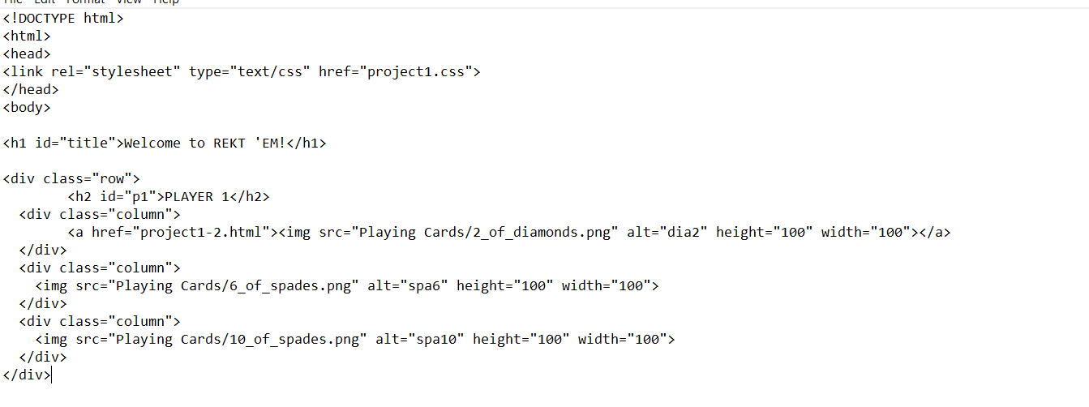
Code insights w/ html

Slide 6
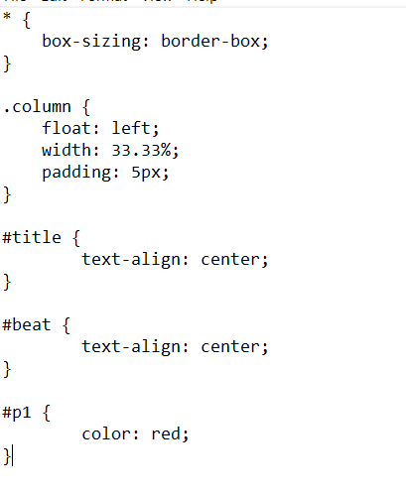
Code Insights w/ css

Slide 7

Demo time!

